Slide 1
Scrum & Agile Processes
Project Management 101

Slide 2
Agile: A Summary
Agile software development refers to a group of software development methodologies based on iterative development, where requirements and solutions evolve through collaboration between self-organizing cross-functional teams.
Agile methods or Agile processes generally promote a disciplined project management process that encourages frequent inspection and adaptation, a leadership philosophy that encourages teamwork, self-organization and accountability, a set of engineering best practices intended to allow for rapid delivery of high-quality software, and a business approach that aligns development with customer needs and company goals.
Agile development refers to any development process that is aligned with the concepts of the Agile Manifesto. The Manifesto was developed by a group fourteen leading figures in the software industry, and reflects their experience of what approaches do and do not work for software development.

Slide 3
Historical Perspectives
Games used to be built using the waterfall methods
Fixed plan
Outcomes may not be as designed
Scrum/Agile adopted since 2000 by companies like EA, Harmonix, Ubisoft etc.
Test & iterate
Allows flexibility in modifying scope/specs if outcome is not as desired
Adapted from Toyota

Slide 4
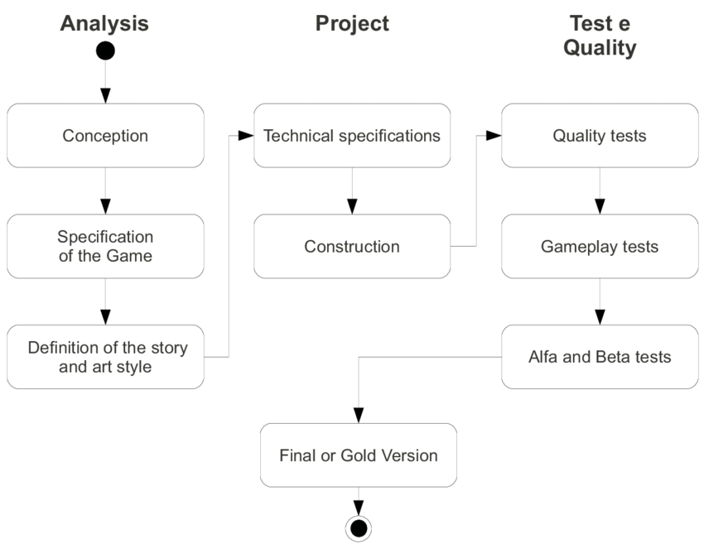
Summary of Waterfall Method

Slide 5
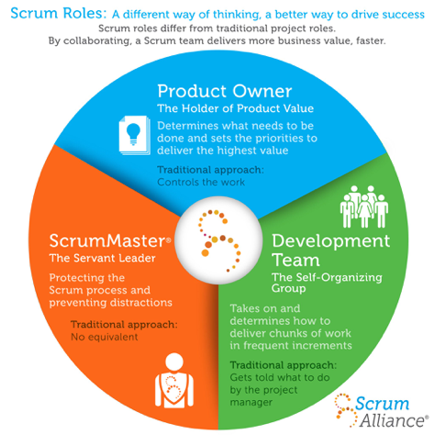
Summary of Scrum Roles

Slide 6
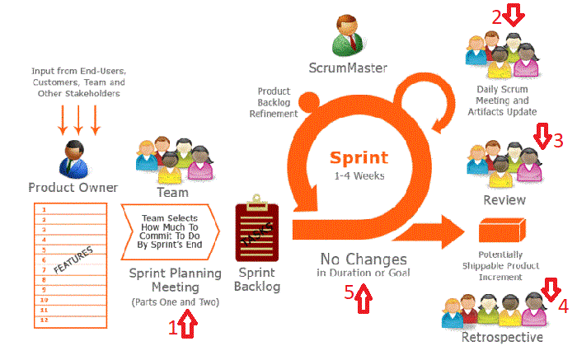
Summary of Scrum Cycle
Step 4: Monitor & Update
What have I done
What will I be doing
What am I dependent on
Every intermediate product must be presentable, usable, to prevent abortive work
Step 1: Gather Facts
Step 3: Execute
No changes in scope
No changes in timebox
Keep team on track
Step 5: Finalise & End
Always give feedback mid-assignment
Step 2: Plan & Delegate

Slide 7
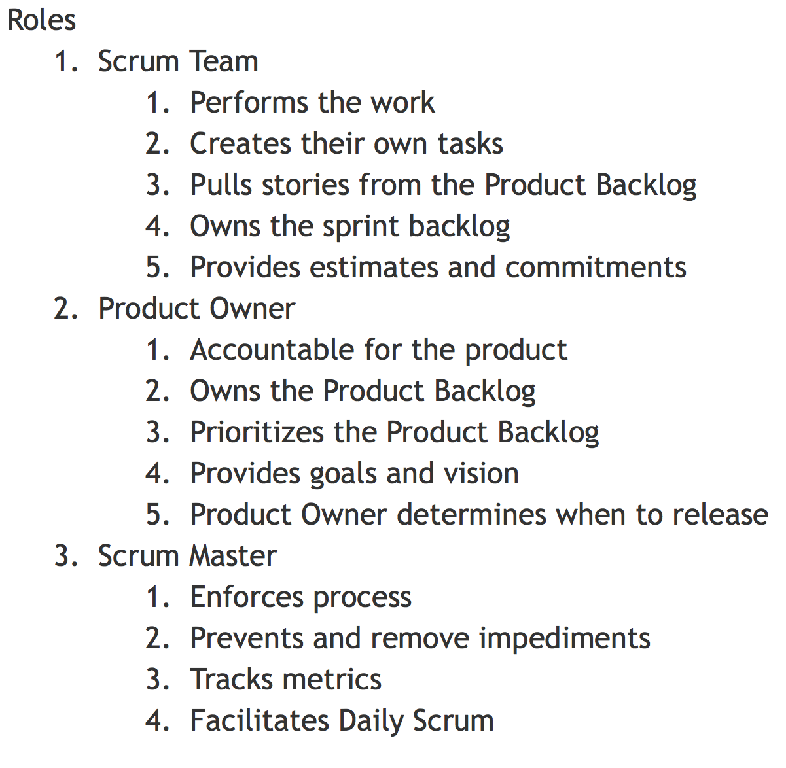
Scrum Pre-Work
Organise in a team
Pick a problem
Discuss and come up with a plan
5 minutes Time Box – Scrum Master keeps time
Defines the problem
Facilitates the problem-solution process

Slide 8
Scrum Pre-Work
Step 1: Gather specs
No more than 100 words
Acknowledge sources for materials used in slides
Read the above as a team
A presentation that summarises the Scrum to explain process
Step 2: Plan & delegate
Step 3: Execute
If you rush into execution and implementation, you might be overly attached to them, even if they are bad from first principles
Step 4: Monitor and update
Step 5: Finalise & end

Slide 9
Scrum Takeaways
A cross-functional team (stable & dedicated)
Team is self-organised and decides on how to get the work done
Team plans 1 Sprint at a time
Product Owner is the Product Vision Holder
Team decides how much can be produced each Sprint – not the Product Owner
Target for each Sprint is clear and doesn’t change
Each Sprint is a time box without extension
Each Sprint produces a ‘potentially shippable product’ (tested, defect-free & done)
Inspect & adapt product and process at the end of each Sprint
alpha – all features tested; beta – no P0 & P1 bugs (e.g. no crashes and show-stopping bugs); go – ready-to-go

Slide 10
Scrum Practice
Goal: See how good your team can get at making airplanes
Each airplane must be made from ¼ of a sheet of A4 paper
Planes must have a blunt tip
Each airplane must be tested and shown to fly 3 meters in the testing area
Planes may only be tested once; if it fails, it must be discarded
Only successfully test planes count toards your goal

Slide 11
Scrum Artifacts
Product Backlog
High-level feature list
Create and owned by the Product Owner
Scrum Board + Sprint Backlog
Scrum Board = Task Board which tracks task status
Sprint Backlog = Task List which tracks task completion
Sprint Burndown Chart
Visualization of the Sprint progress
Shows velocity

Slide 12
Not Started | Estimated Time | Assignment | Dependency | In Progress | Done
1. Research aerodynamics of parachute | 3 | YYK | -
2. Decide on shape of parachute and object to float | 2 | YYK | 1
3. Assemble tools | 5 | Nicole | -
4. Collect toilet paper | 3 | Xuan Ping | -
5. Tear toilet paper | 2 | Xuan Ping | 4
6. Make synthetic strings | 5 | Nicole | 3
7. Cut tape | 3 | YYK | 3
8. Tie string to object | 2 | Xuan Ping | 3, 6
9. Thread string through paper | 5 | Nicole | 8

